Slide 1
Using Jupyter to Empower Enterprise Analysts
Dave Stuart
Department of Defense
@somedavestu
github.com/nbgallery

Slide 2
About me
15 years in the Intelligence Community
Multiple large scale adoptions of technology
Last 3 years leading Jupyter efforts

Slide 3
This Presentation
Jupyter in the Intelligence Community
Challenges of enterprise-wide adoption of Jupyter

Slide 4
Analysis in the IC

Slide 5
Analysis in a Large Enterprise
Large analytic user-base
Diverse and highly dynamic mission space
Pairing analysts to developers doesn’t scale

Slide 6
Analysis in a Large Enterprise
Use many different tools to access data
Weave together manual workflow
Use Excel for analysis

Slide 7
Reality
“I recognized how much of my day was spent doing menial tasks – writing queries, bouncing different tools off each other, manipulating my data in various ways.”

Slide 8
Jupyter as a Solution

Slide 9
Jupyter as a Solution
Developers writing scripts → Analysts writing reproducible workflows

Slide 10
Jupyter as a Solution
“Instead of thinking about my workflow largely in terms of tools, I’ve started thinking about it more in terms of questions and data.”

Slide 11
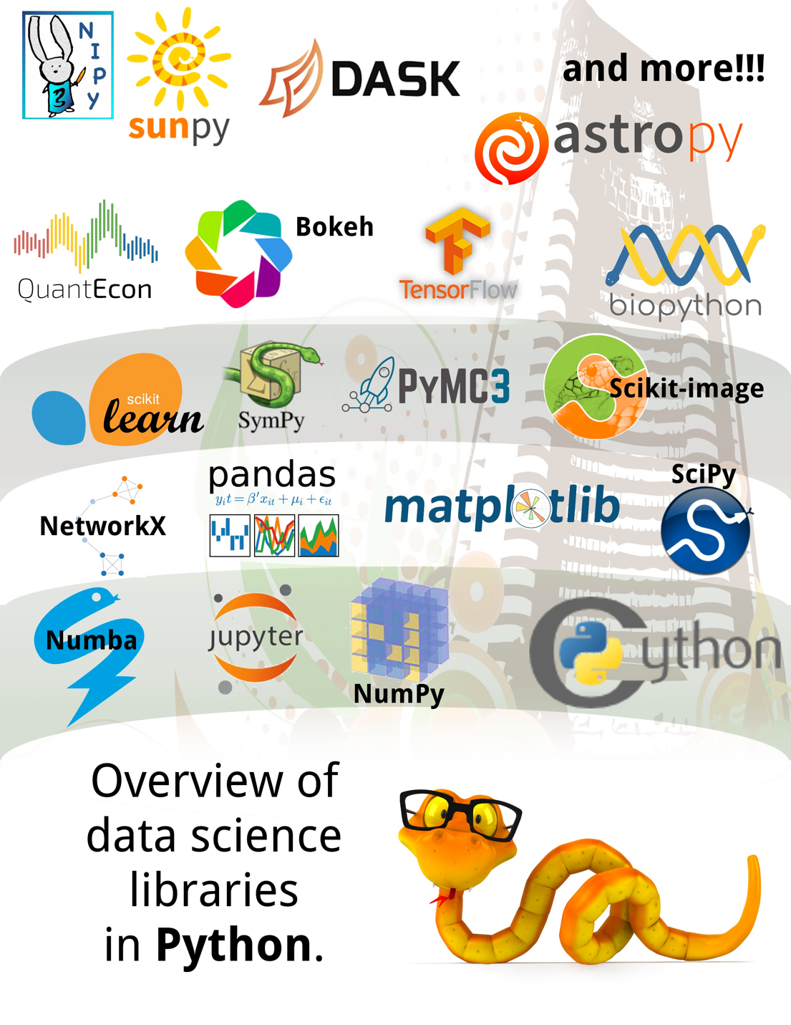
Python Ecosystem

Slide 12
Goals for Jupyter
Efficiency
Collaboration
Approachability

Slide 13
Enterprise Challenges And Some Solutions

Slide 14
Enterprise Challenges
User-base
Collaboration
Data Security
Compliance

Slide 15
User-Base Challenges
Mostly non-coders
Domain knowledge experts
Tasked with deriving insight from data
Huge untapped coding potential

Slide 16
Collaboration Challenges
Large geographically dispersed user-base
Maximize discovery and collaboration

Slide 17
Data Security Challenges
Sensitive subject matter
Extremely fine grained security
Input data varies by time and user

Slide 18
Compliance Challenges
System accreditation
Retention
Oversight

Slide 19
Our Approach

Slide 20
Jupyter Execution Environment
Unified execution environment
Ephemeral personalized virtual machines
Creates a micro data science environment

Slide 21
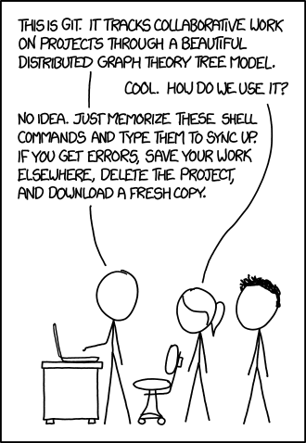
nbgallery sharing and collaboration platform (code only)
Open source released
Easy-to-use repository of community-authored notebooks

Slide 22
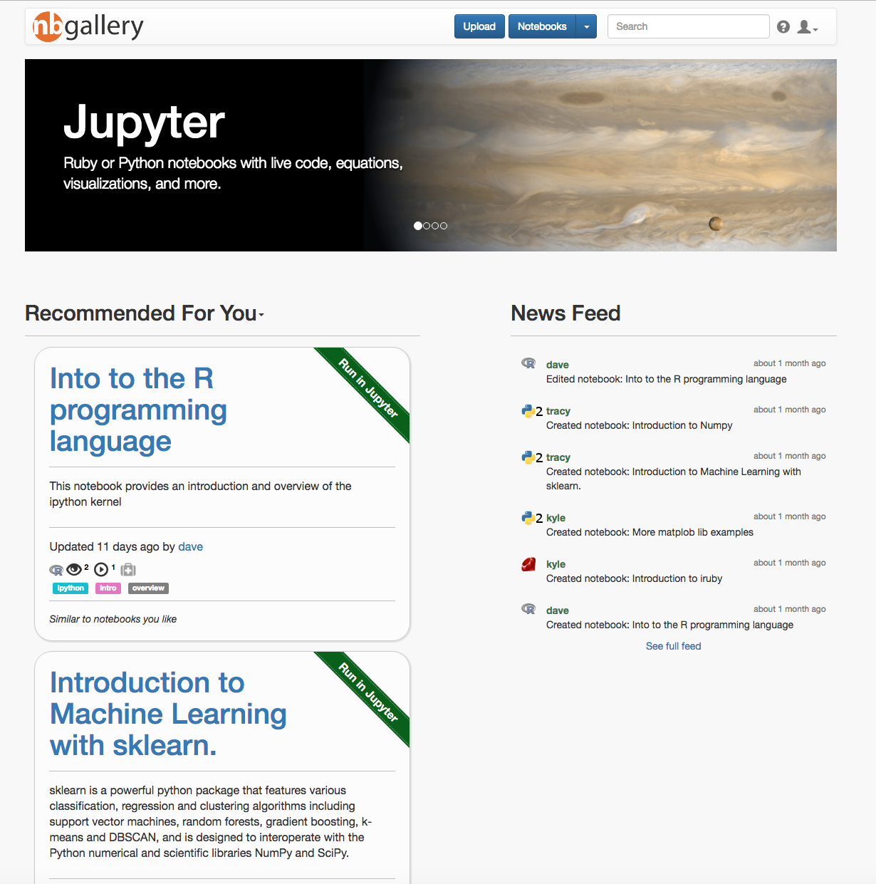

Slide 23
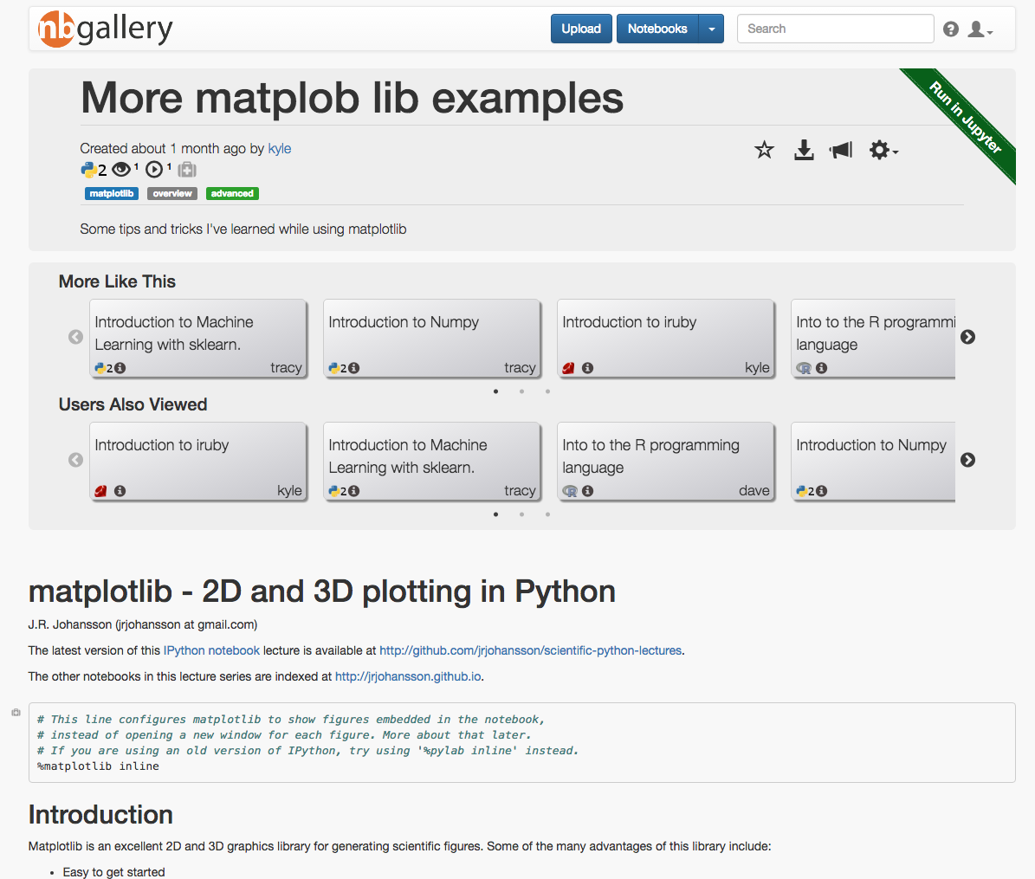

Slide 24
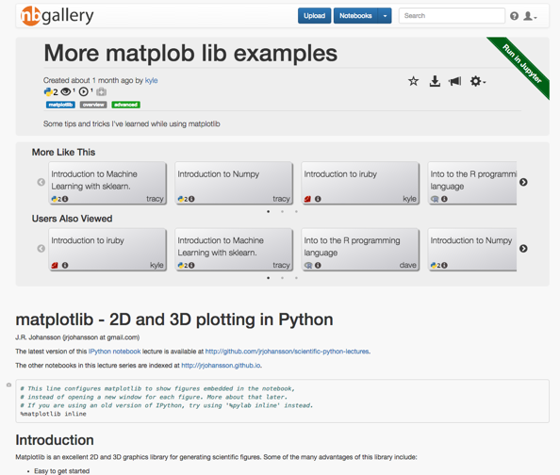
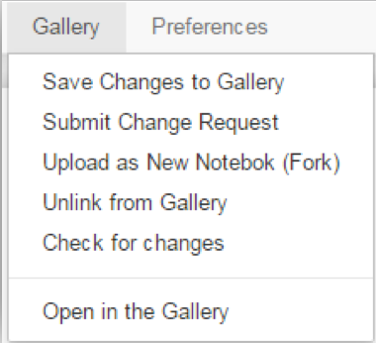
Tie Together Decoupled Environments

Slide 25
What have we addressed?
User-base
Collaboration
Compliance
Data Security

Slide 26
Collaboration at Enterprise Scale

Slide 27
Collaboration Challenges
High volume and redundancy
Recommendations
Notebook health

Slide 28
: Recommendations
Recommend notebooks to users based on:
Notebook usage
Non-personalized recommendations
Personalized recommendations
White paper: https://nbgallery.github.io/recommendation.html

Slide 29
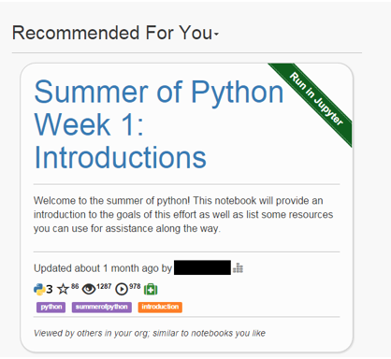
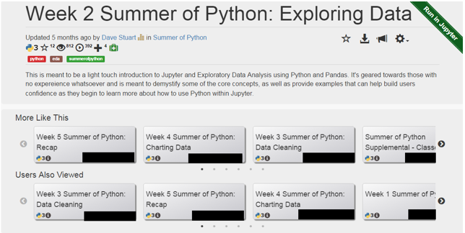
: Recommendations

Slide 30
: Notebook Health
Broken notebooks decrease confidence
How to define health?
Why not use automated tests?

Slide 31
How We Measure Notebook Health
A notebook is only healthy if the cells are healthy
The further a user makes it the better
Repeated use and more users builds confidence
Health decays over time
White paper: https://nbgallery.github.io/health_paper.html

Slide 32
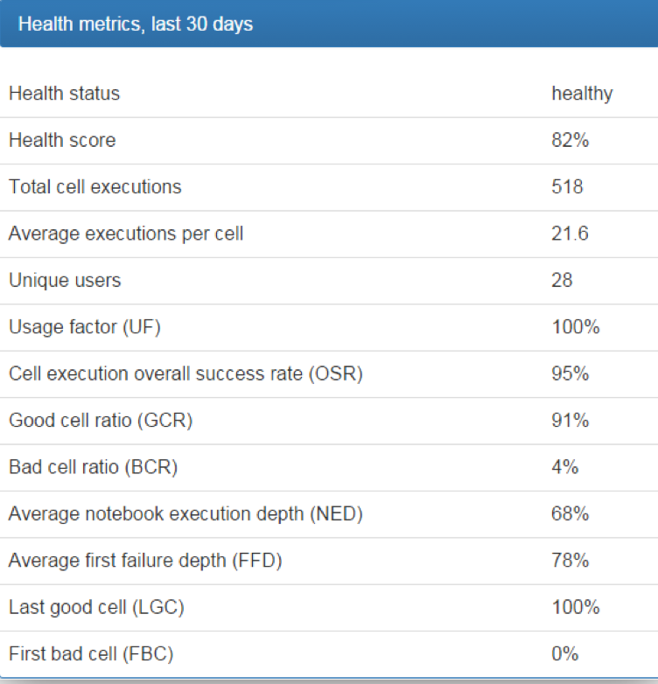
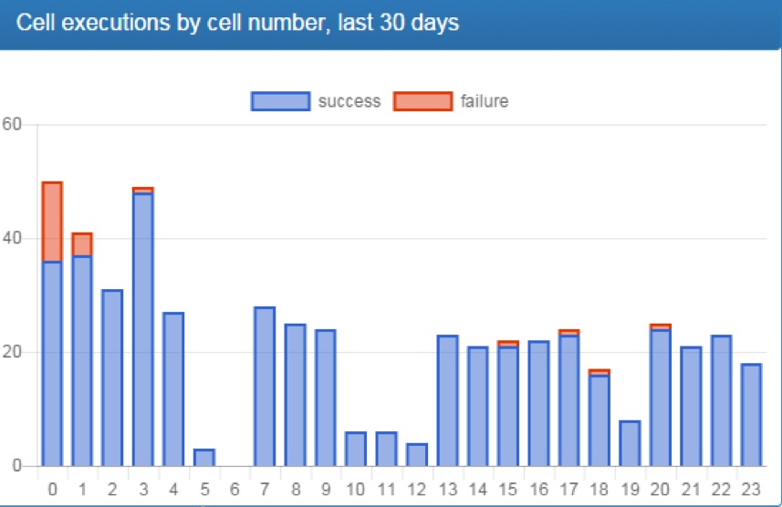
: Notebook Health

Slide 33
Python Training and Outreach

Slide 34
Analyst-level Training
Find balance between training and a demanding workload
Success doesn’t mean new computer/data scientists
But rather an analyst who can use some code

Slide 35
Learning to Code is not a Career Shift
“Learning to code is not a career shift, but a means to better think about and tackle my workflow.”
“I worried that learning enough code to actually add value would be a bigger time commitment than I was willing to make…I’d been wrong about how much value I could add even with just some basic coding skills. Even as a beginner, I’ve written several notebooks that automate parts of my workflow or manipulate my data in a way that helps me make quicker, better sense of it all.”

Slide 36
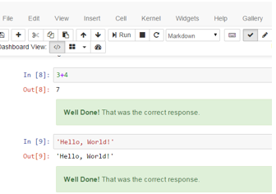
Intro to Python for Analysis
Demystify code to nontraditional coders
Flipped classroom using Jupyter notebooks
Virtual and in-person mentoring

Slide 37
Provide Metrics to Users
“It seems like a little thing on its face, but I want to specifically applaud this. Automating collection of ‘news you can use’ metrics reduces toil and drag, improves morale, and hopefully improves our efficacy. Numeric metrics aren’t mission impact, but ‘making the numbers cheap’ is a great start.”

Slide 38
Results and Use

Slide 39
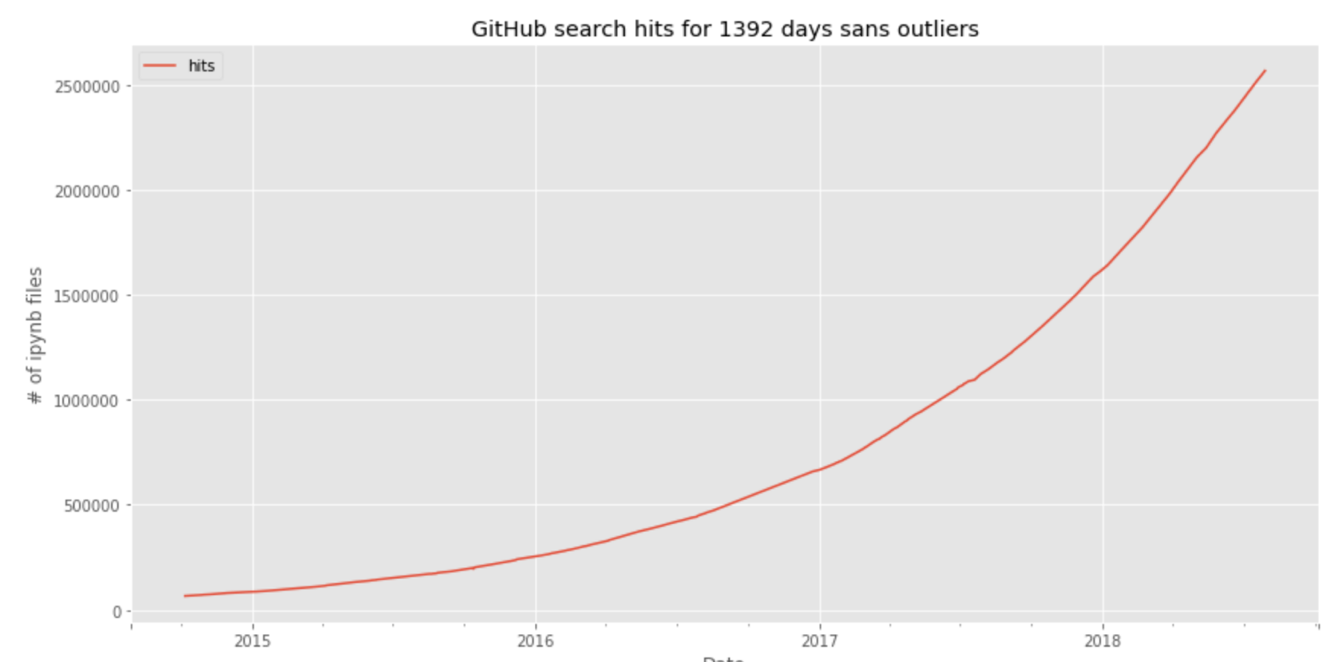
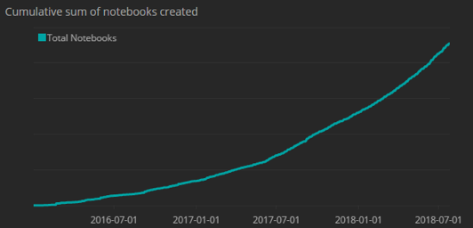
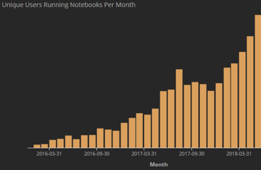
Current Status
1000’s of users
1000’s of notebooks by 100’s of authors
10:1 ratio of notebook users to authors

Slide 40
Notebook Use-Cases
Operational
Course Material
Building Blocks

Slide 41
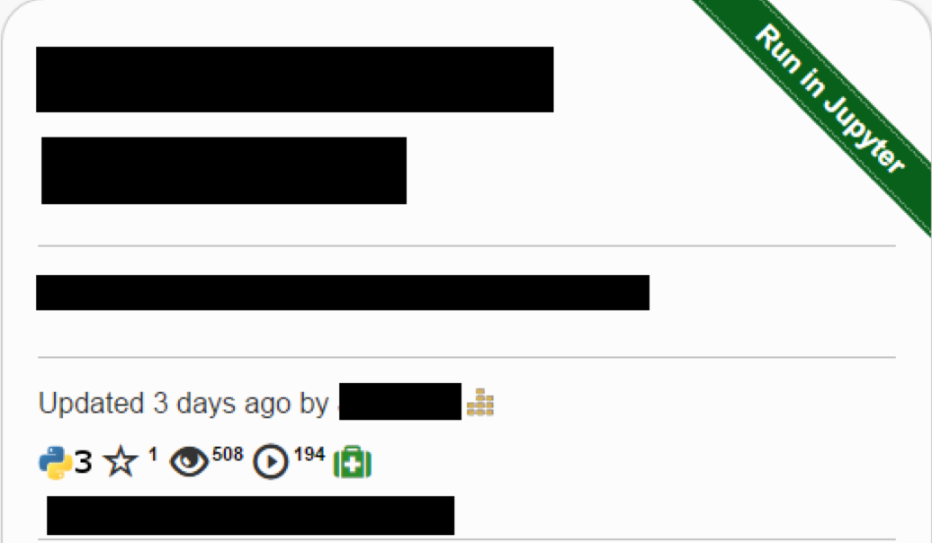
Notebook Use-Cases: Operational
Supports a business/mission function
Uses data from corporate repositories
Most prompt users for query parameters

Slide 42
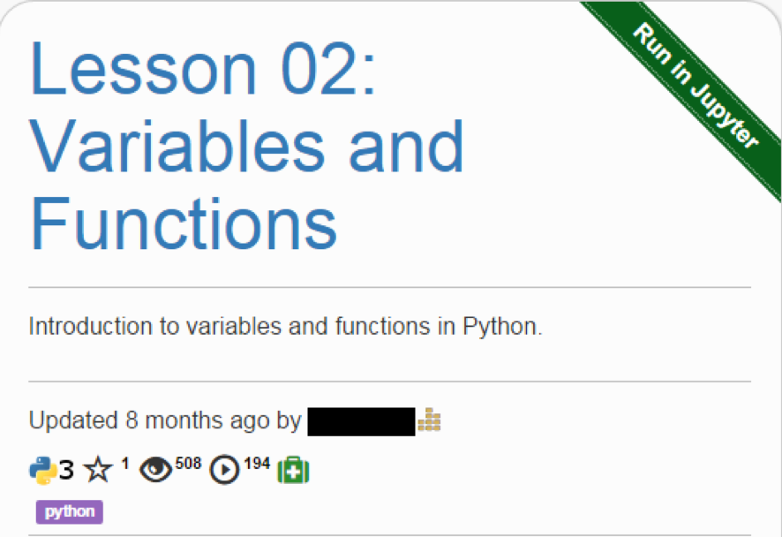
Notebook Use-Cases: Course Material
Notebooks in formal training series
Teach code within the same platform they can use for business purposes

Slide 43
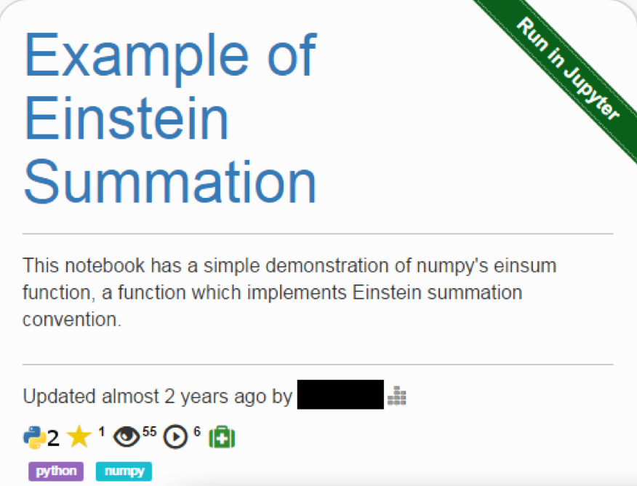
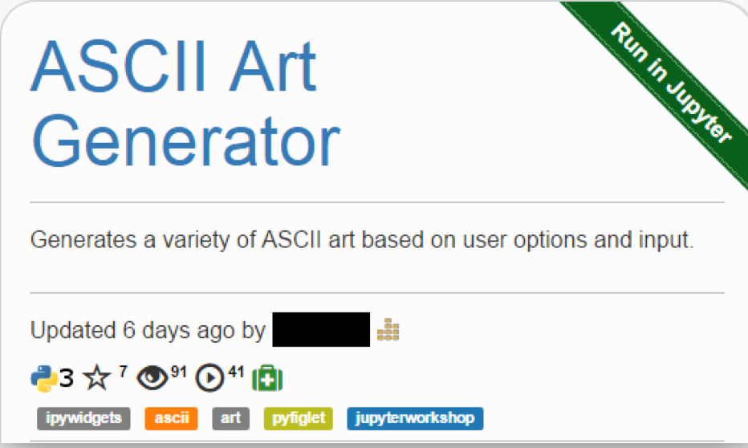
Notebook Use-Cases: Building Blocks
Organic use-case
Reproducible code snippets shared within the community

Slide 44
Notebook Use-Cases
48% Operational
13% Course Material
39% Building Blocks

Slide 45
Future Efforts

Slide 46
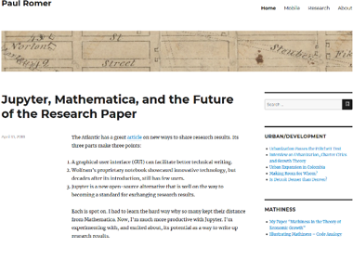
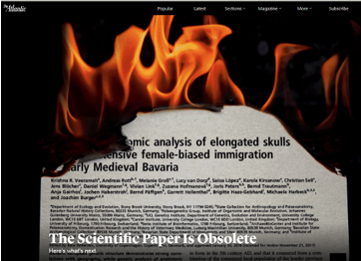
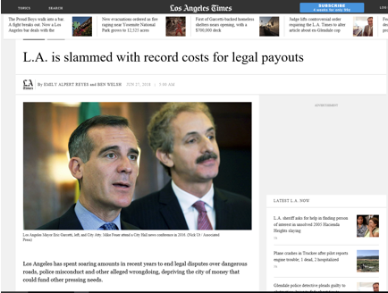
Jupyter for Reporting
Mirror Jupyter for reporting/dissemination use-cases

Slide 47
Questions?
@somedavestu
github.com/nbgallery

